Slide 1
Bifurcation angle and stenosis of the carotid artery
Introduction to Cardiovascular Mechanics
Tej Jolly

Slide 2
Background

Slide 3
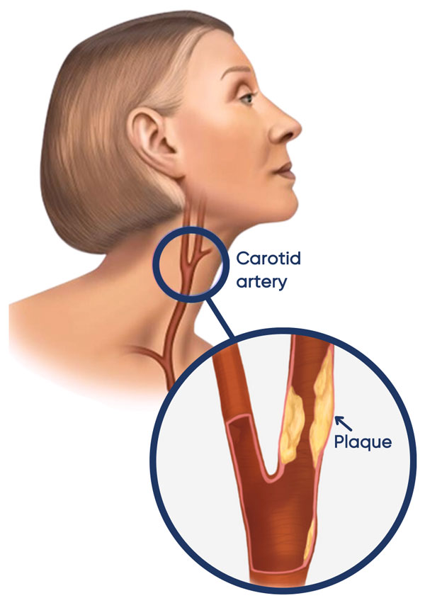
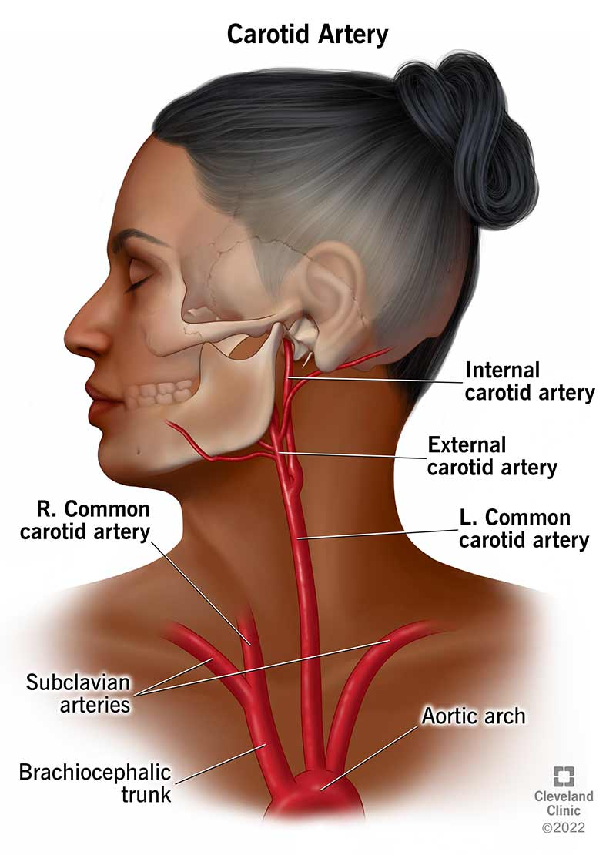
Notes:
Internal - carries blood to the brain and eyes
External - supplies the face, tongue, and scalp
[1] - https://www.harbourvascular.com.au/conditions/stroke-mini-stroke-carotid-artery-disease/
[2] Cleveland clinic
Study will focus on atherosclerosis and the hemodynamic factors that contribute to the disease development

Slide 4
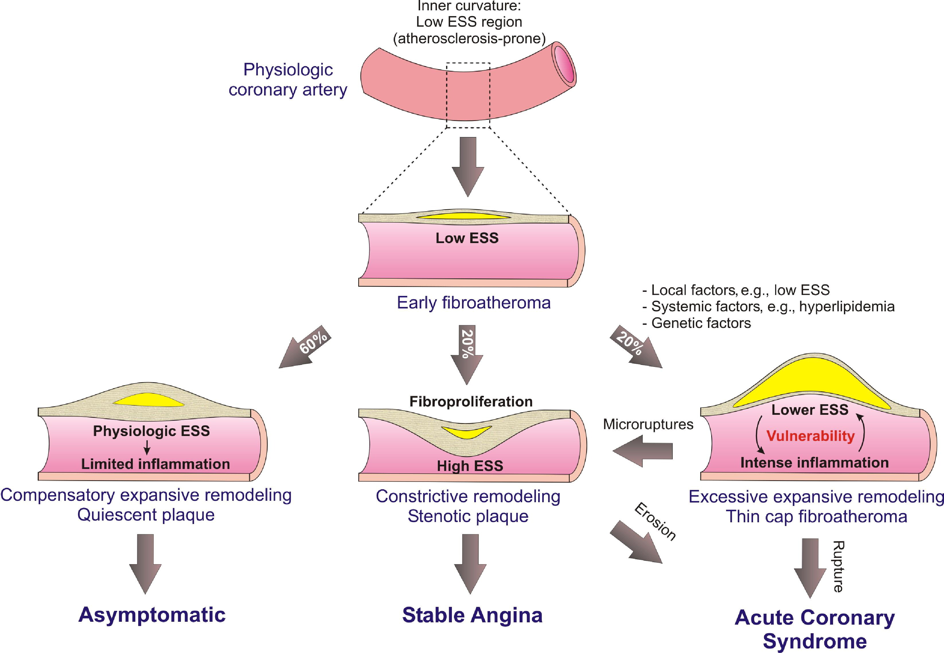
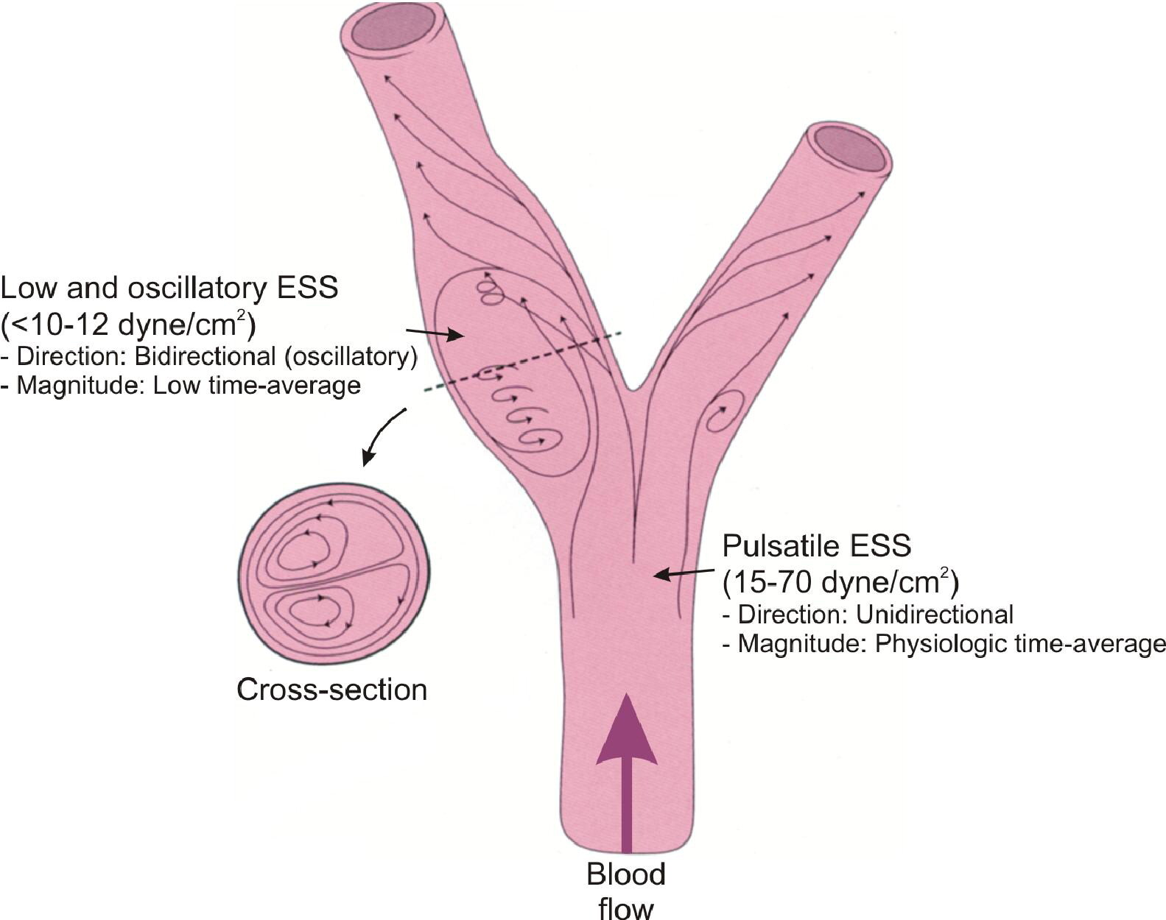
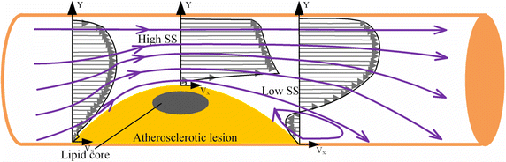

Slide 5
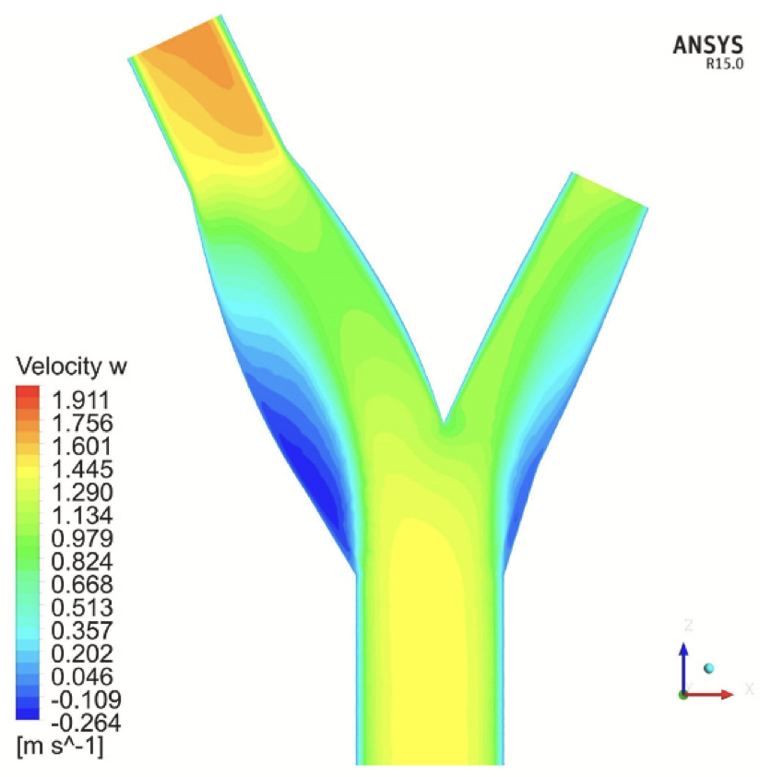
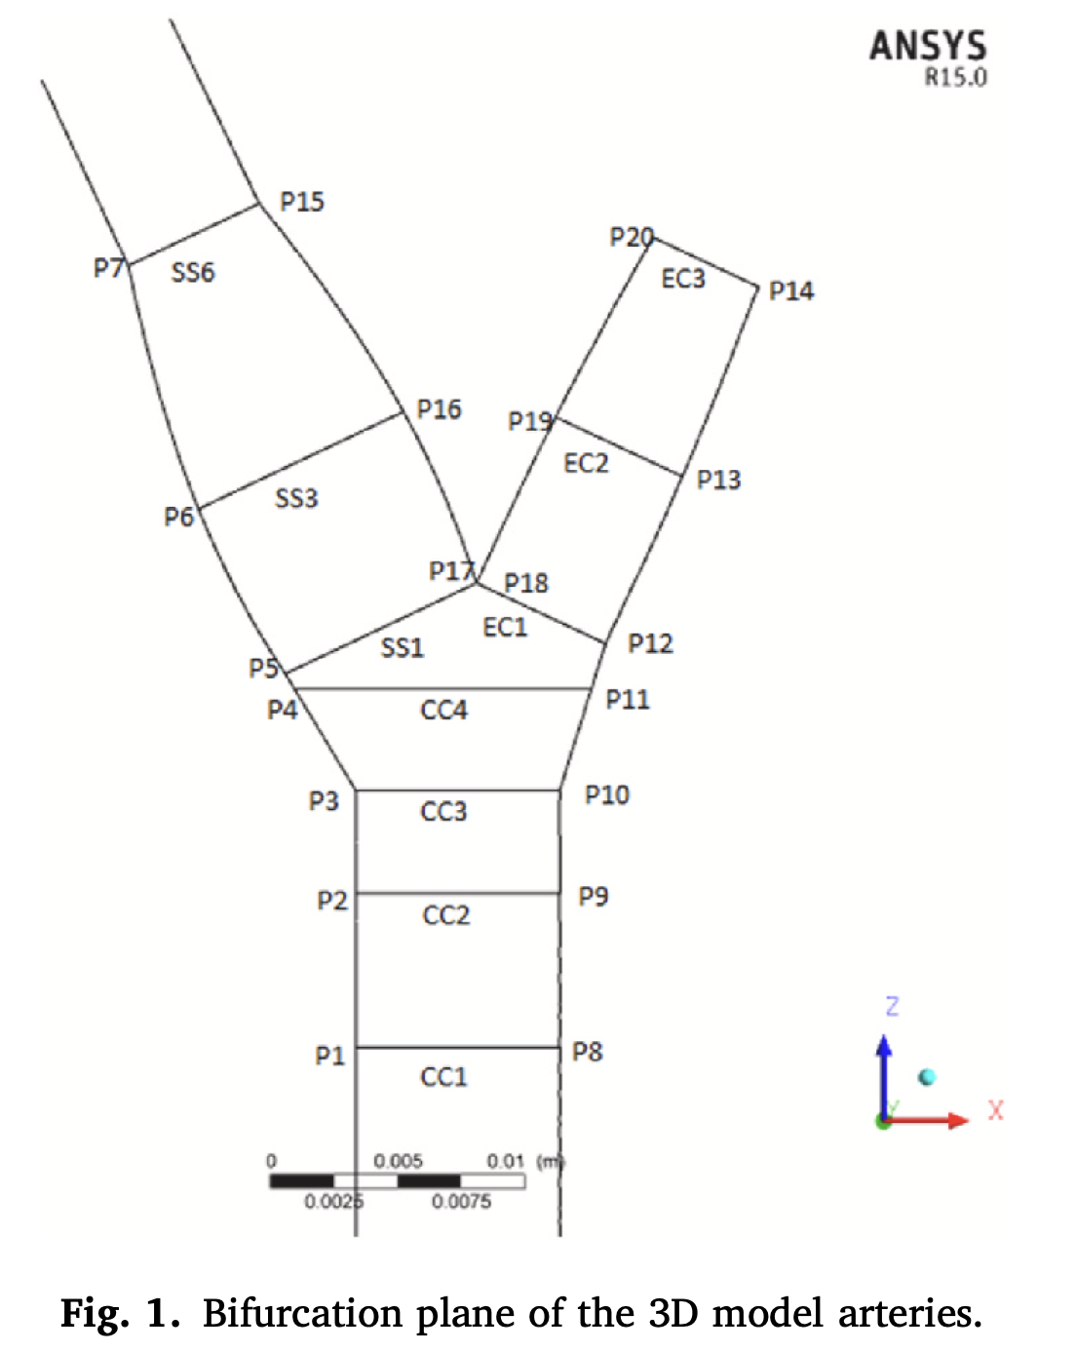
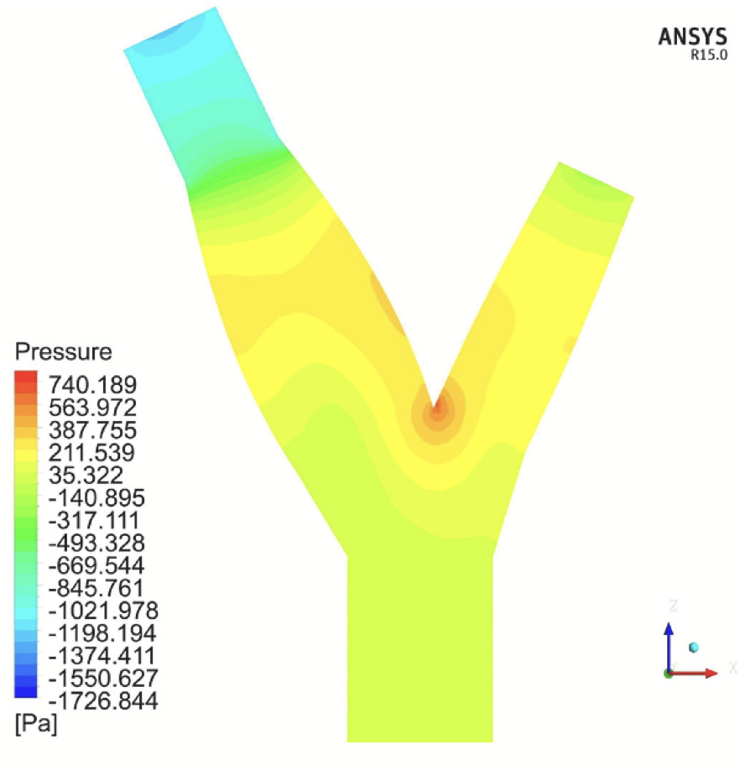
Bashar et al. (2024)
Notes:
Absolute minimum at P4 and P 11
Maximum at P7 and P14
t
P17 to P16 decreasing (to minimum)
P16 to P15 – increasing (to peak)
P5 to P6, relatively low, peaks towards max at P7

Slide 6
Methodology

Slide 7
⍺
⍺
Notes:
Absolute minimum at P4 and P 11
Maximum at P7 and P14
t
P17 to P16 decreasing (to minimum)
P16 to P15 – increasing (to peak)
P5 to P6, relatively low, peaks towards max at P7

Slide 8
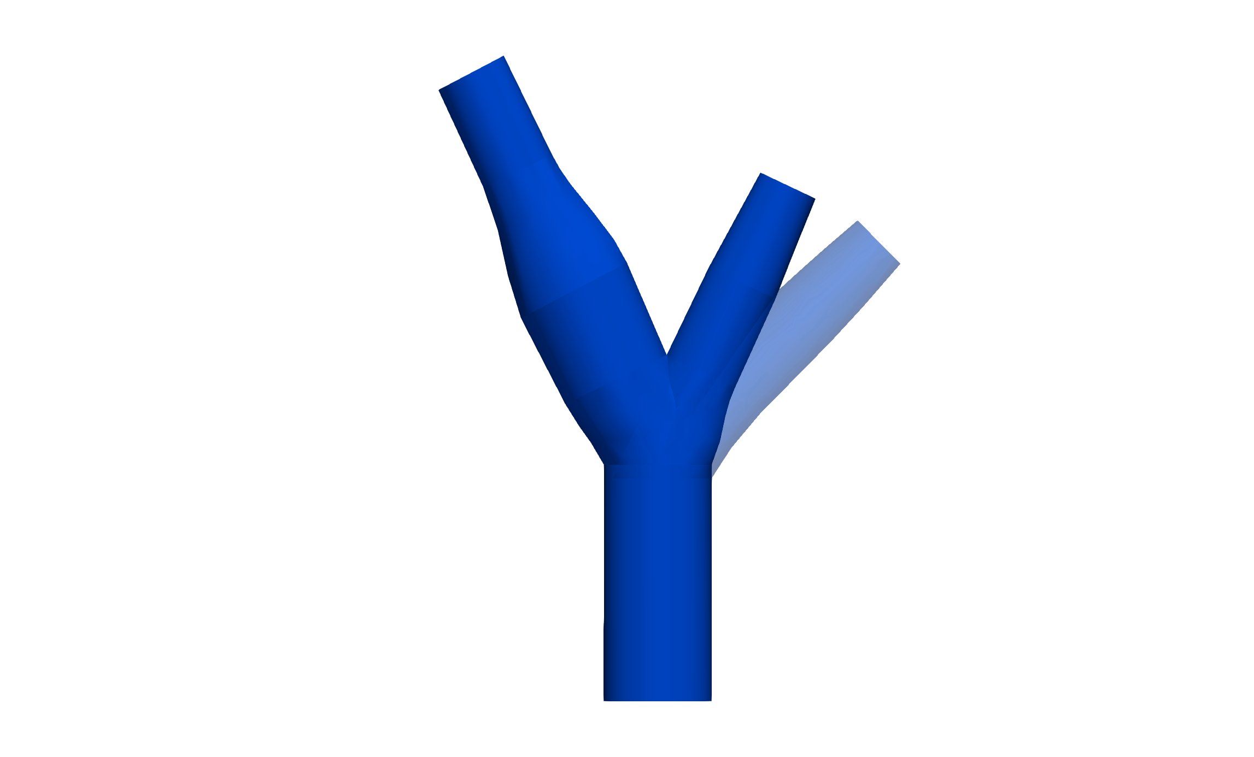
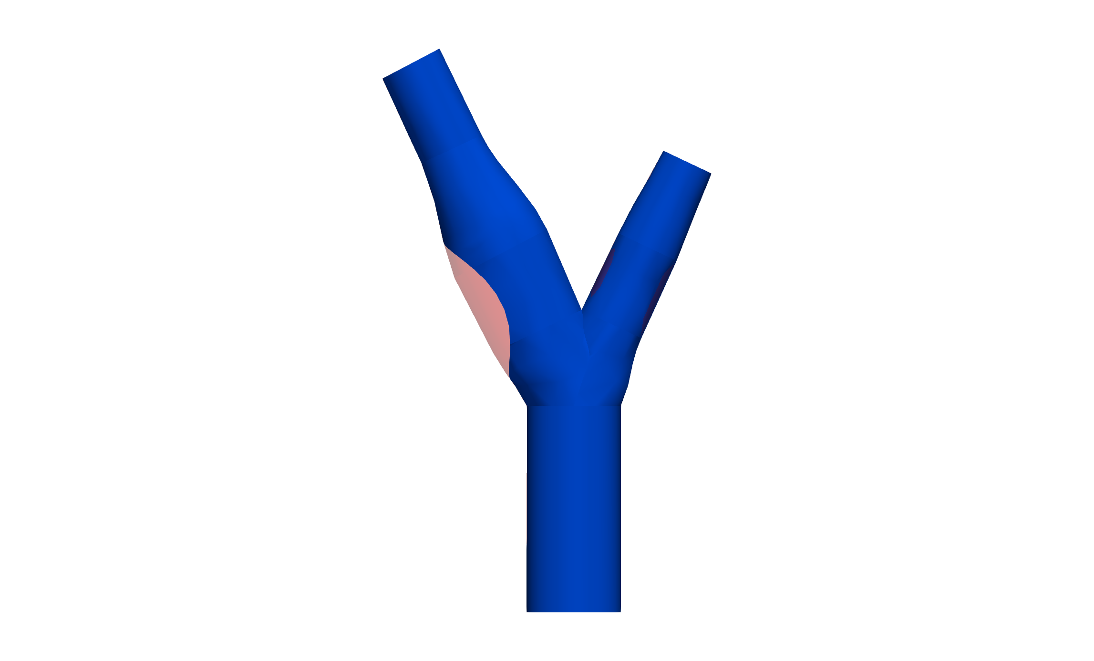

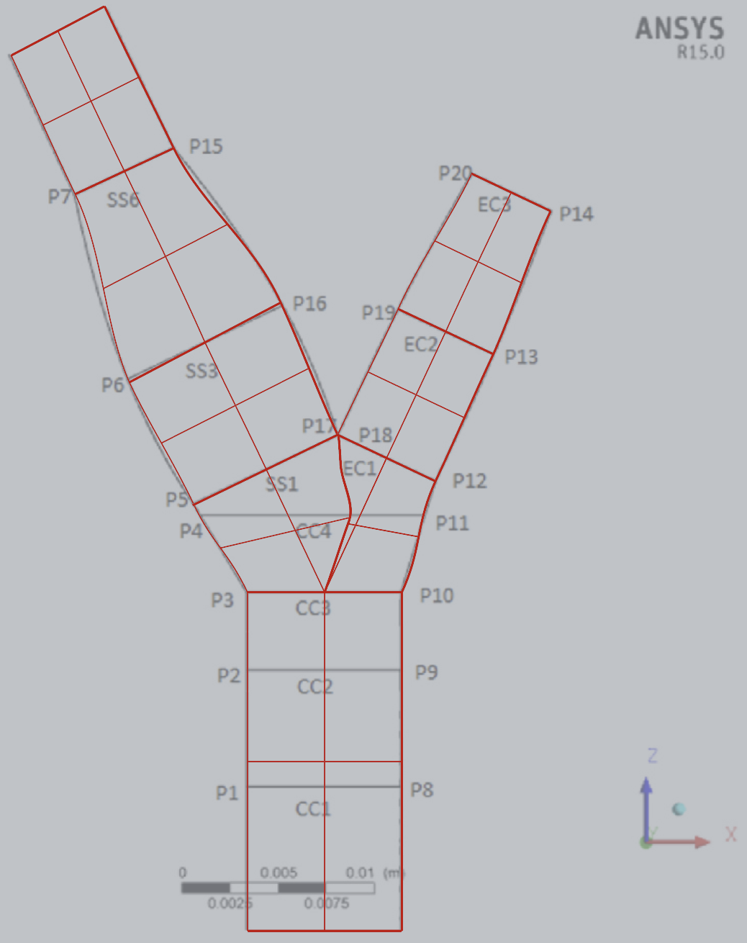
+20°
-30%
Notes:
Absolute minimum at P4 and P 11
Maximum at P7 and P14
t
P17 to P16 decreasing (to minimum)
P16 to P15 – increasing (to peak)
P5 to P6, relatively low, peaks towards max at P7

Slide 9
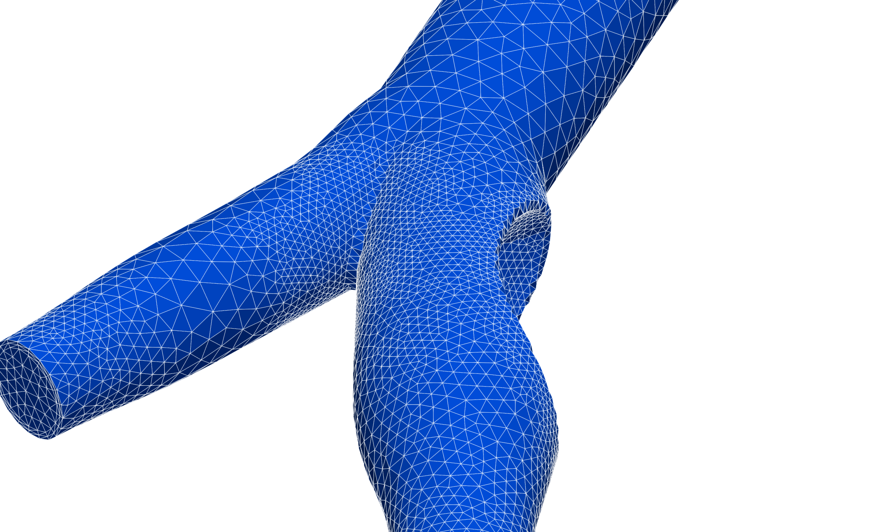
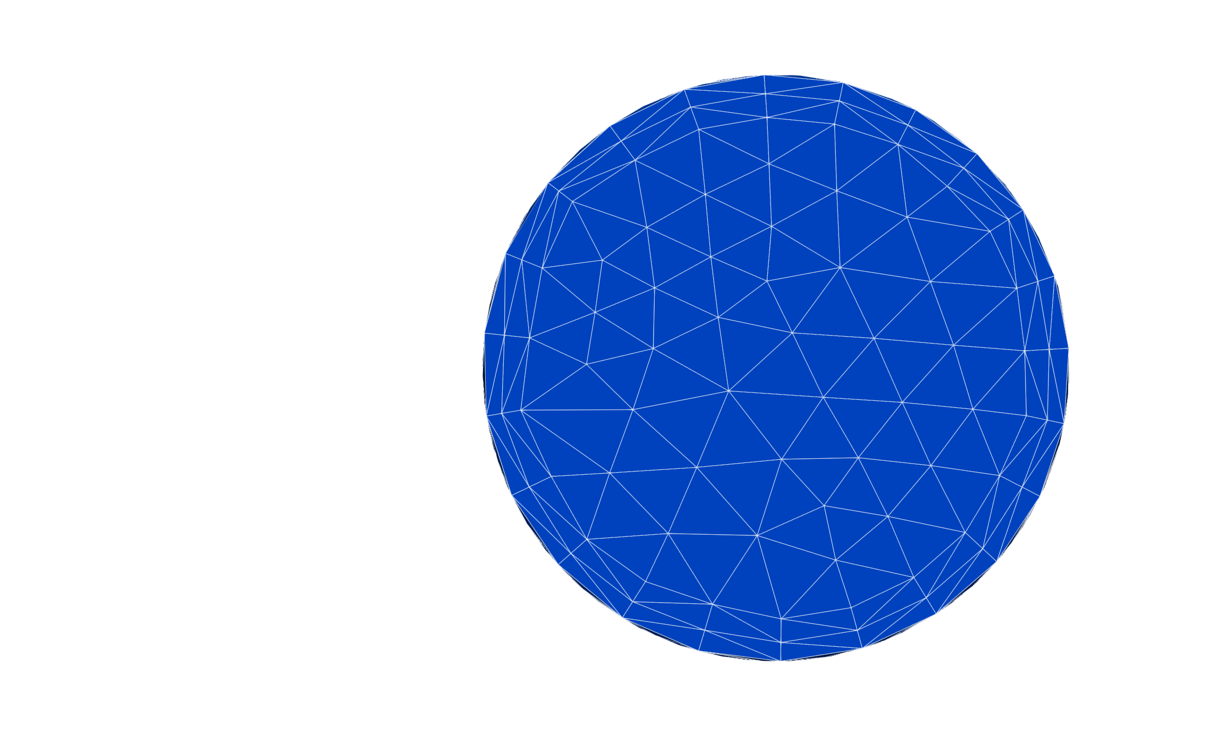
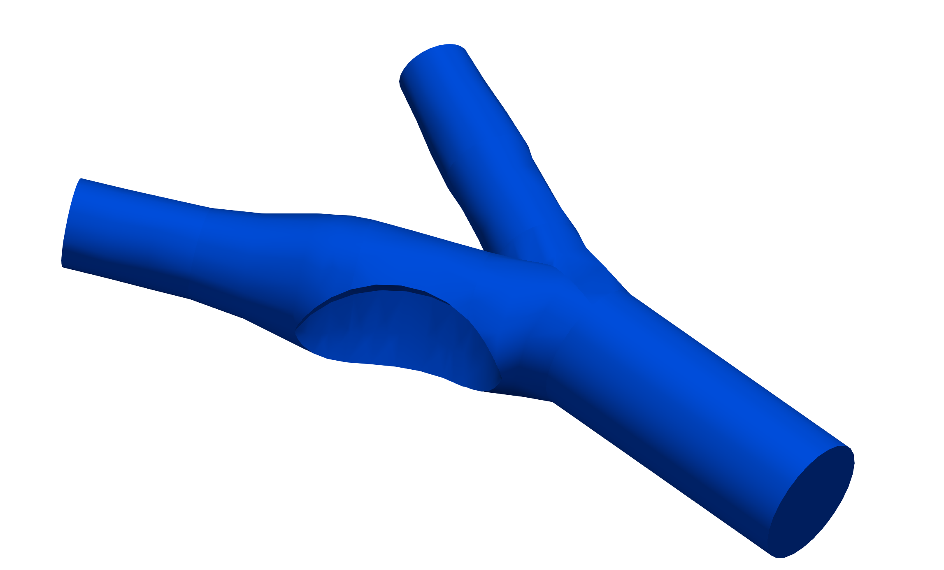
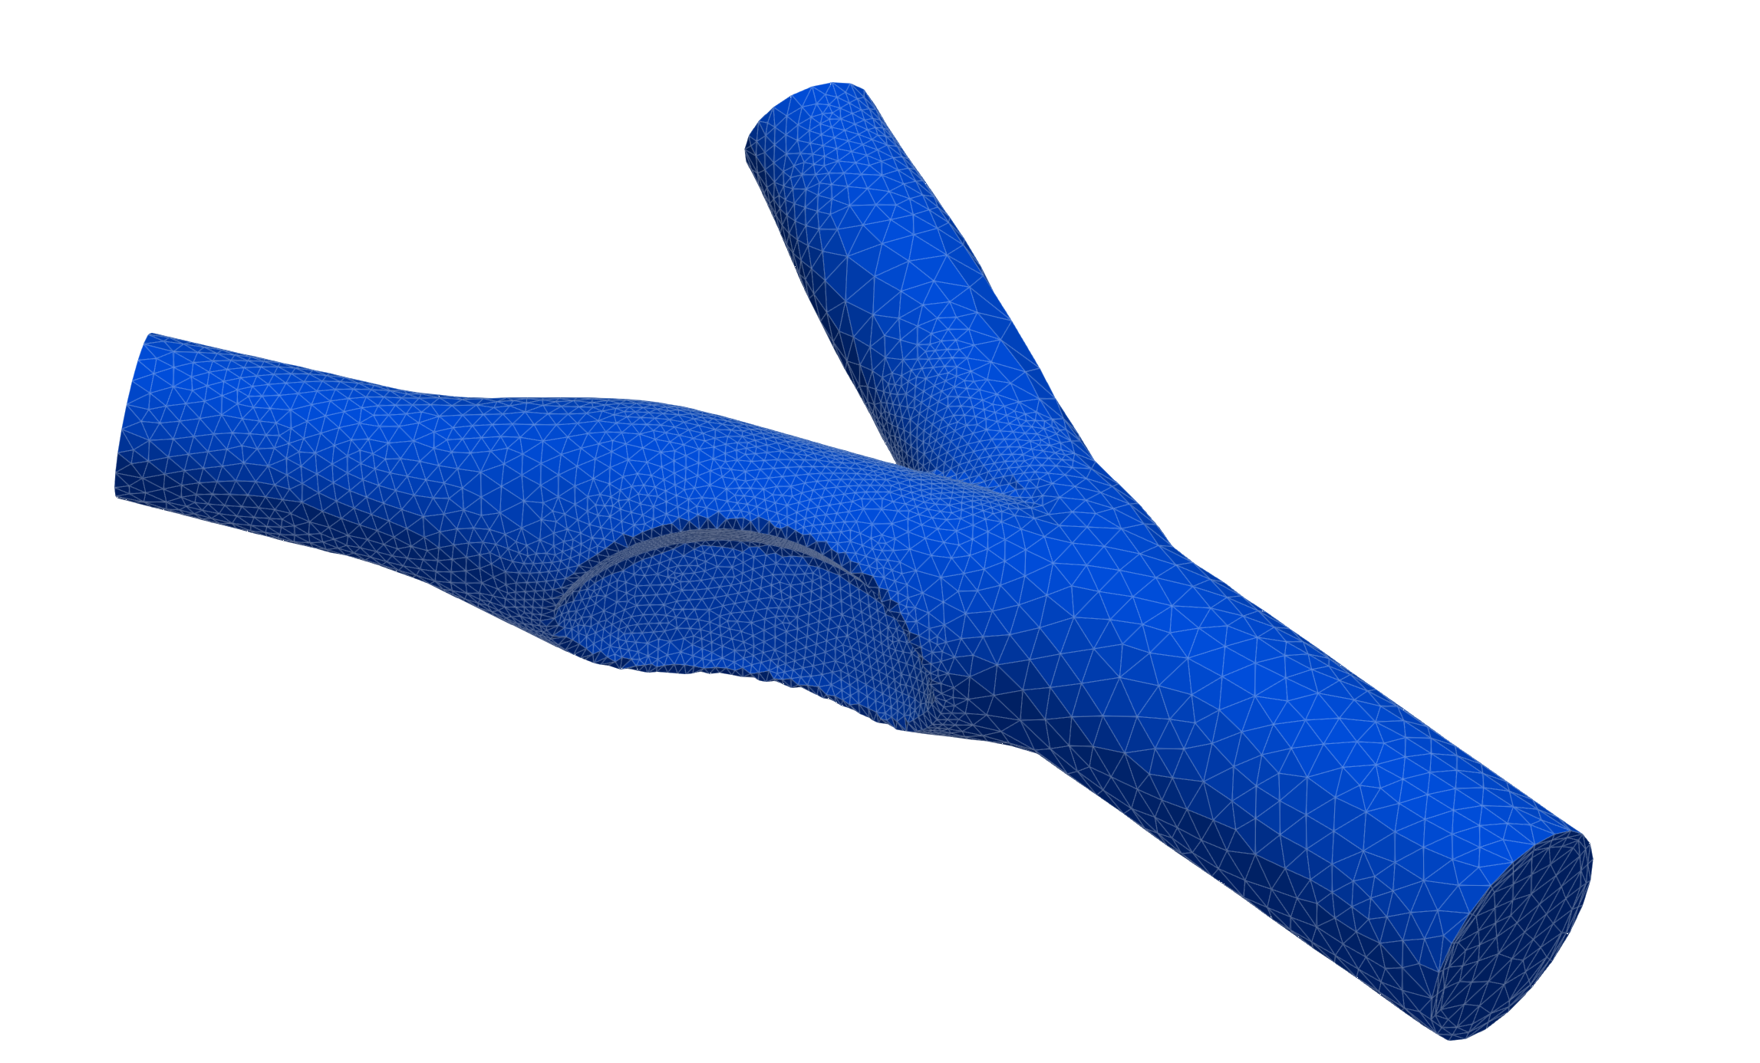
3 boundary layers
Local refinement
1.7 x 10⁵ elements

Slide 10
Results

Slide 11
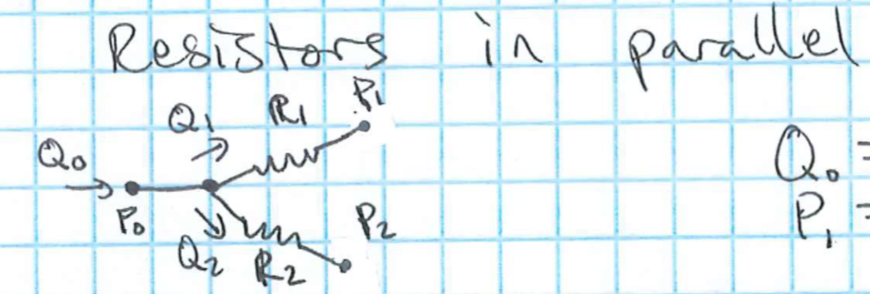
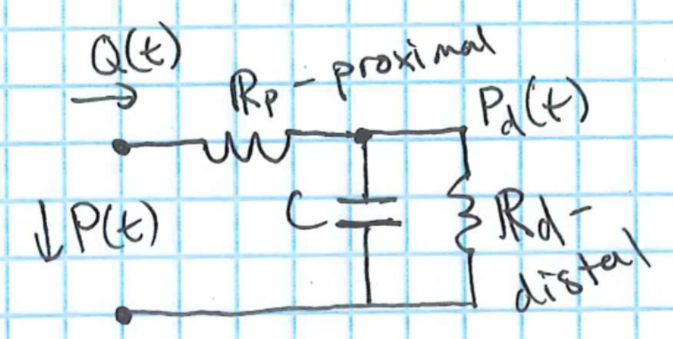
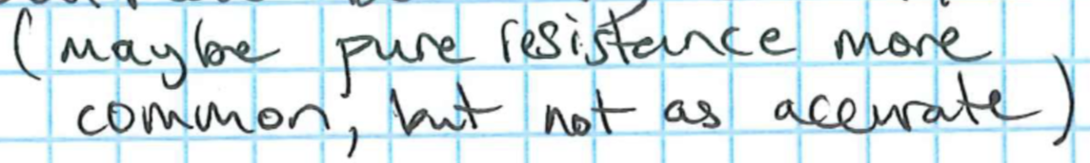
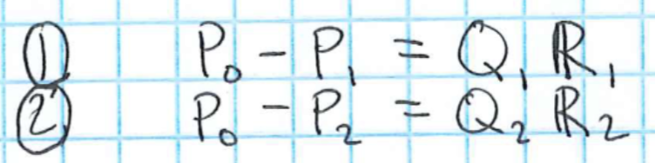
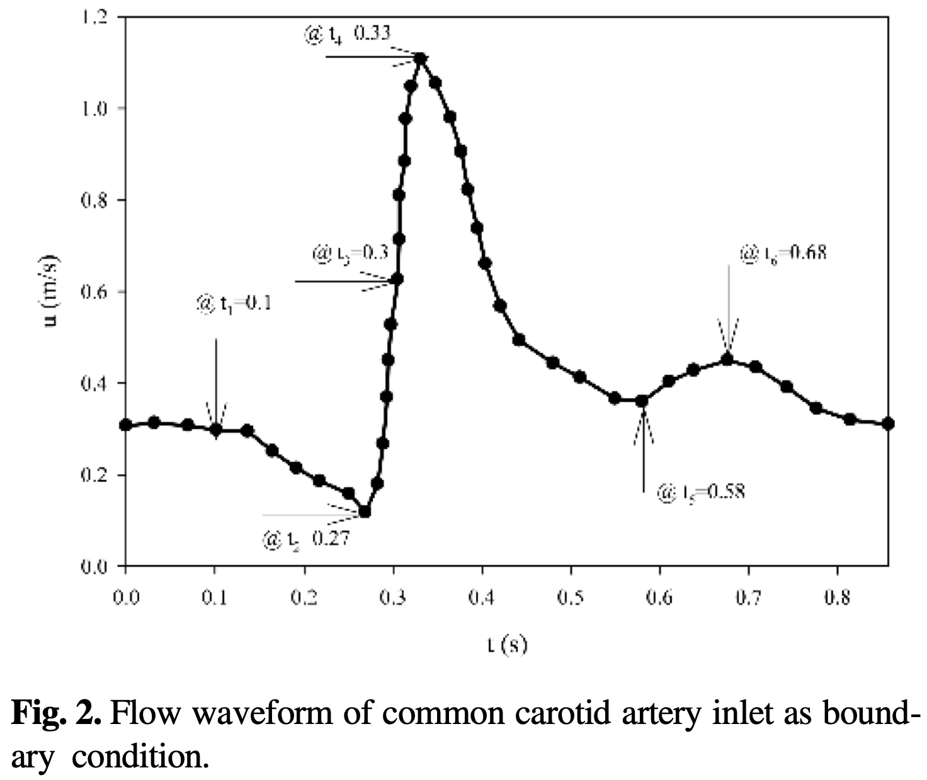
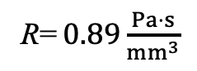
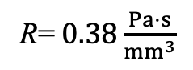
R= $0.38\frac{Pa⋅s}{mm^{3}}$
R= $0.89\frac{Pa⋅s}{mm^{3}}$
70 %
30 %
0.7 Q_{o}
0.3 Q_{o}
P = 120 mmHg
No-slip
Q_{o}
Bashar et al. (2024)

Slide 12
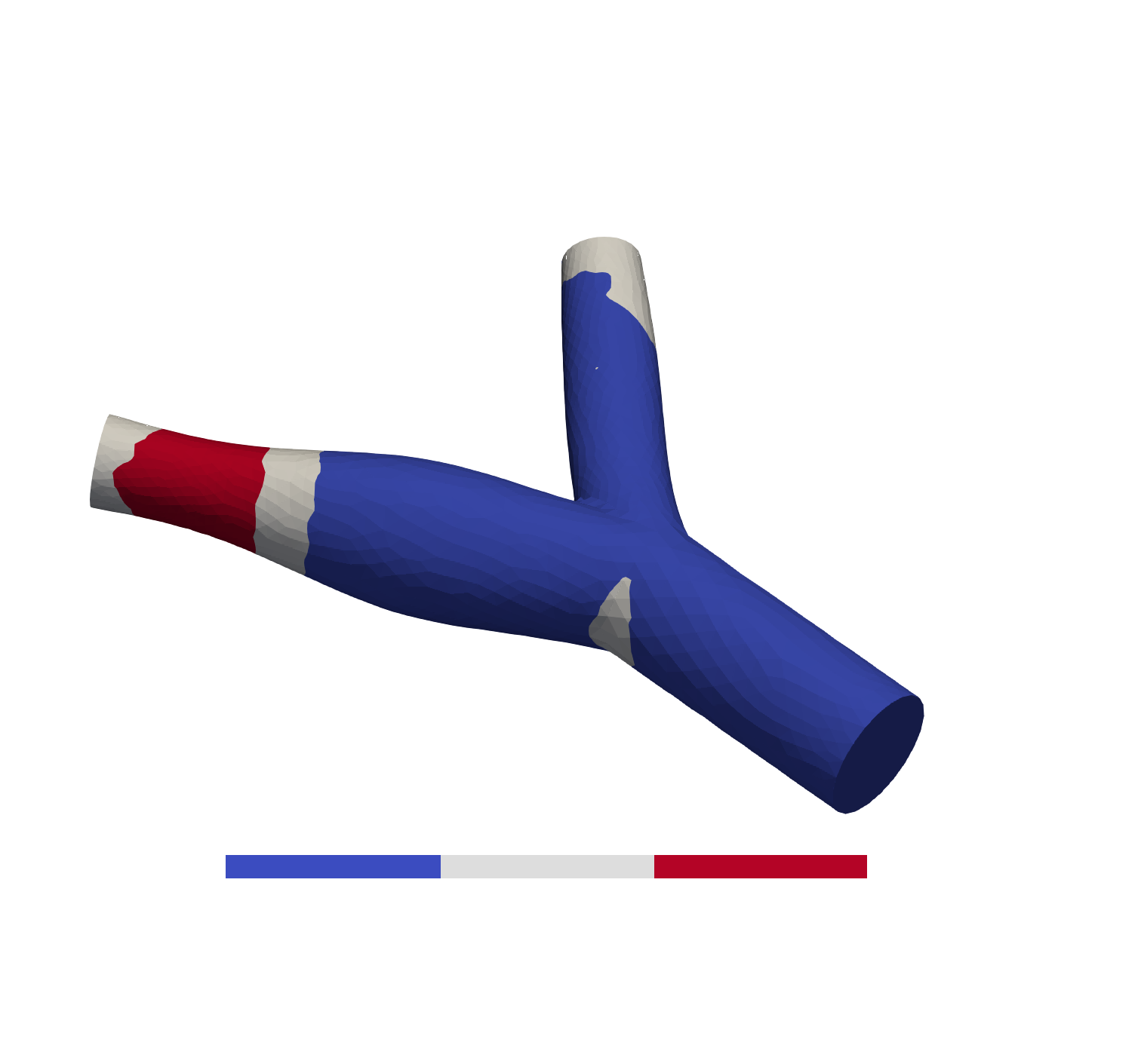
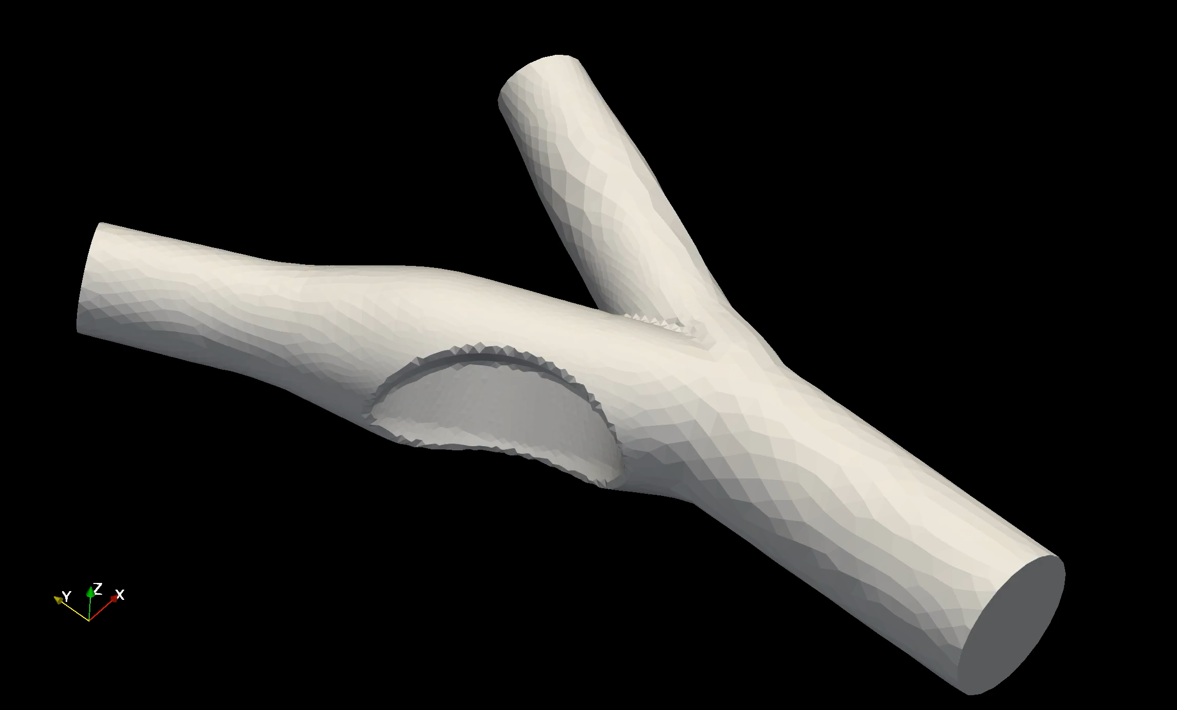
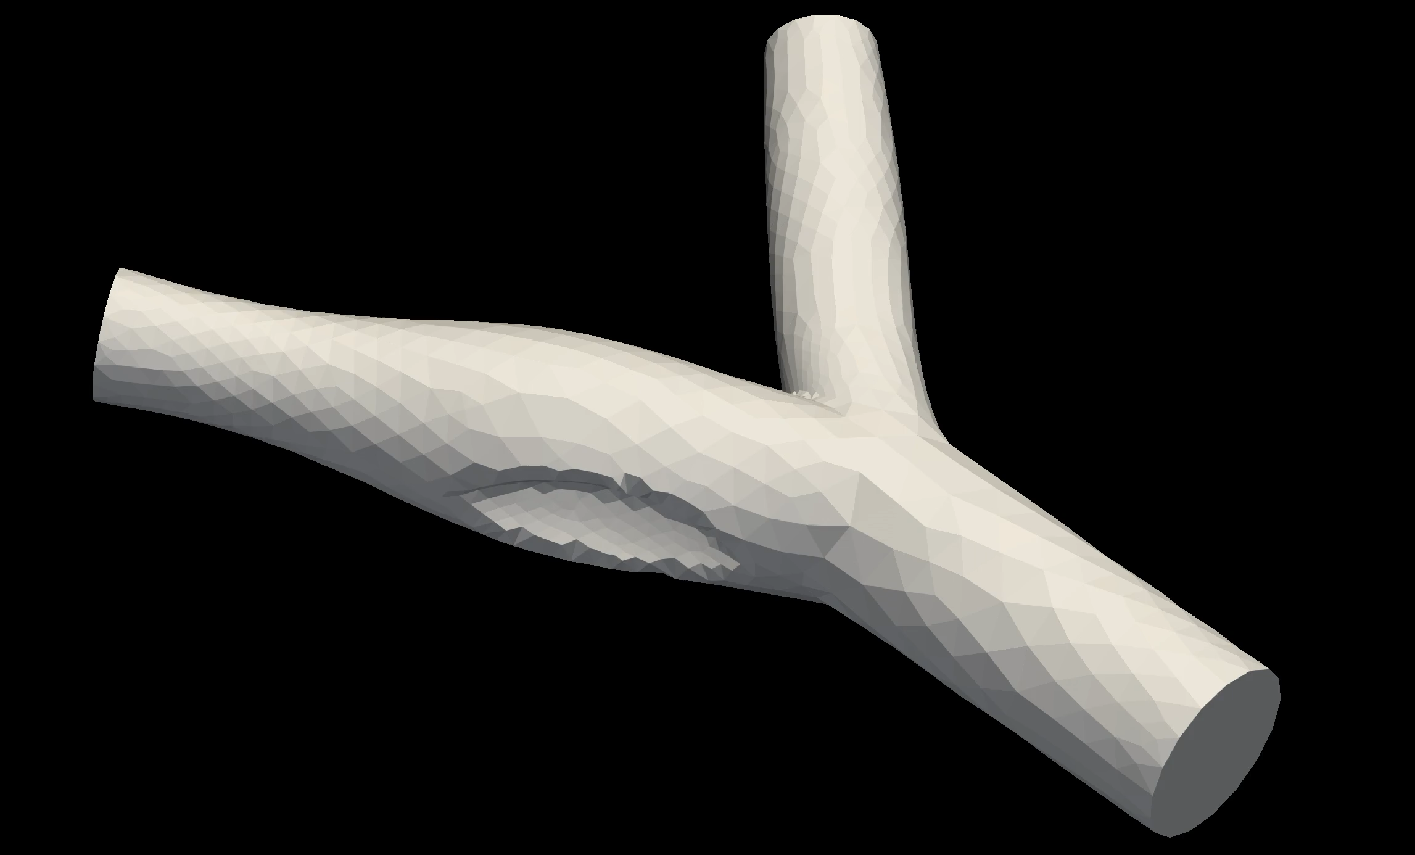


5
70 [dyne/cm2]
30 %
Stenosis [%]
0 %
50°
70°
Bifurcation Angle [deg.]

